Slide 1
Cyclistic bike-share
By: Aditya Gulati Last Update : 10th September 2022

Slide 2
Background
Cyclist have two types of customers : causal and member
Member users are subscribed to the annual membership
Causal customers pay per ride
To improve the business the company wants to convert the causal customer to member customers.

Slide 3
Main Objective
Objective is to find out how casual customers use the cyclist app differently than the member customers.
This will help the marketing team in understanding on which area to focus for promoting Membership.

Slide 4
Datasets
Using the 12 months of data of Cyclistic bike share app.
The data was produced by the company and stored in an open data source website. Hence, data is publicly available and is reliable.
After filtering and processing our dataset includes the user id, type of customers, starting and ending time of ride, what type of bike used, length of ride, and on what weekday.

Slide 5
Findings

Slide 6
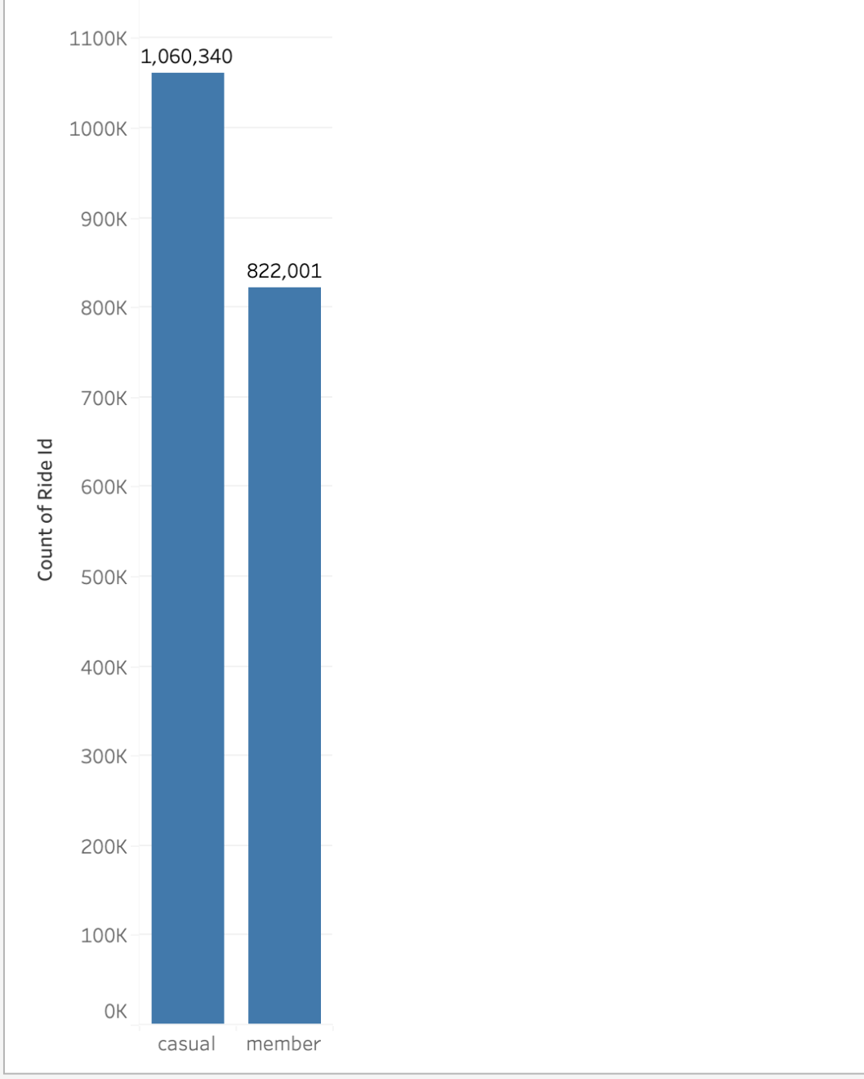
Number of Rides
In the past 12 months, Casual Customers has completed more trips than Member Customers

Slide 7
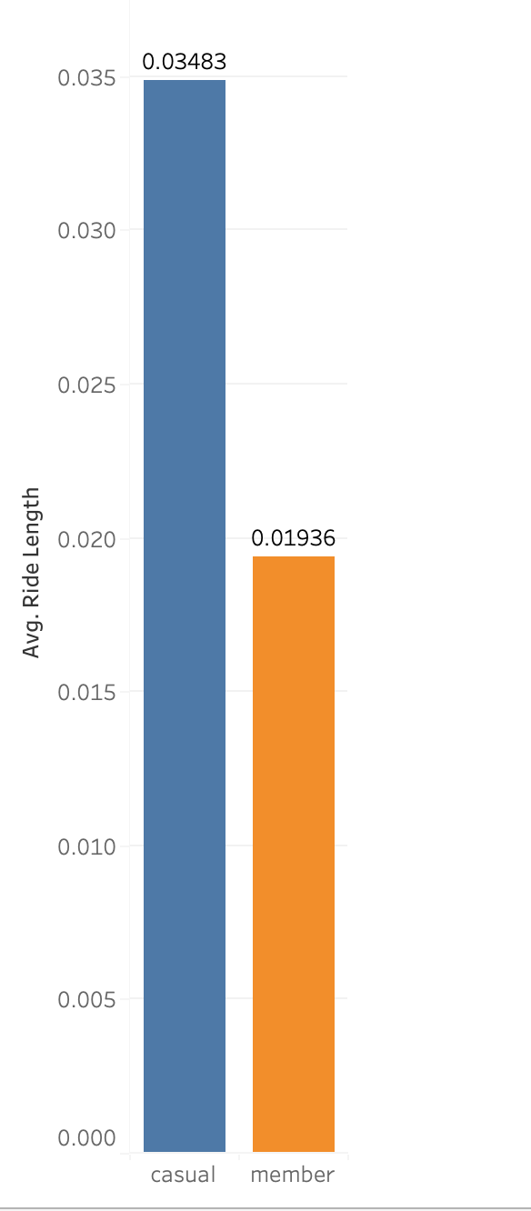
Avg. Ride Length
Avg. ride length for the trips done by casual customers is way longer than member customers

Slide 8
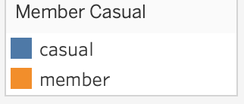
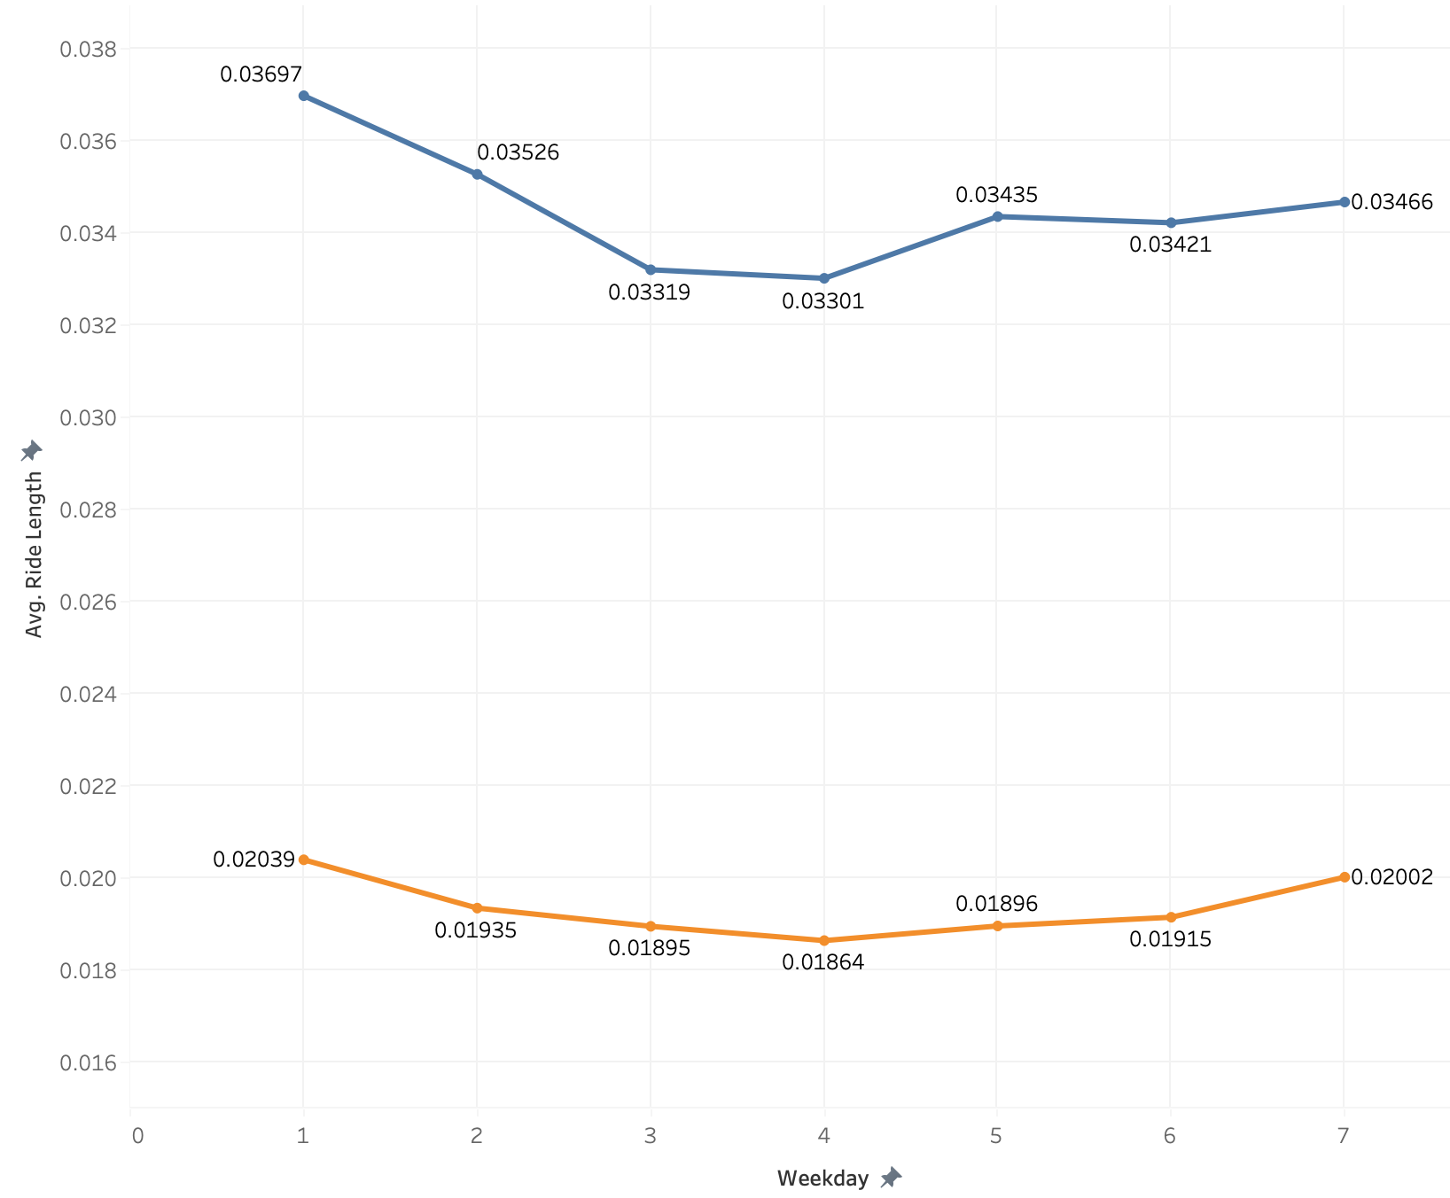
Weekday vs Avg. Ride Length
Casual customers longest average rides occurs during Sunday and Monday. There is huge gap in the length of rides done on Sunday and Monday and the rest of the week.
Member customers show similar trajectory but the average length of rides are consistent throughout the week.

Slide 9
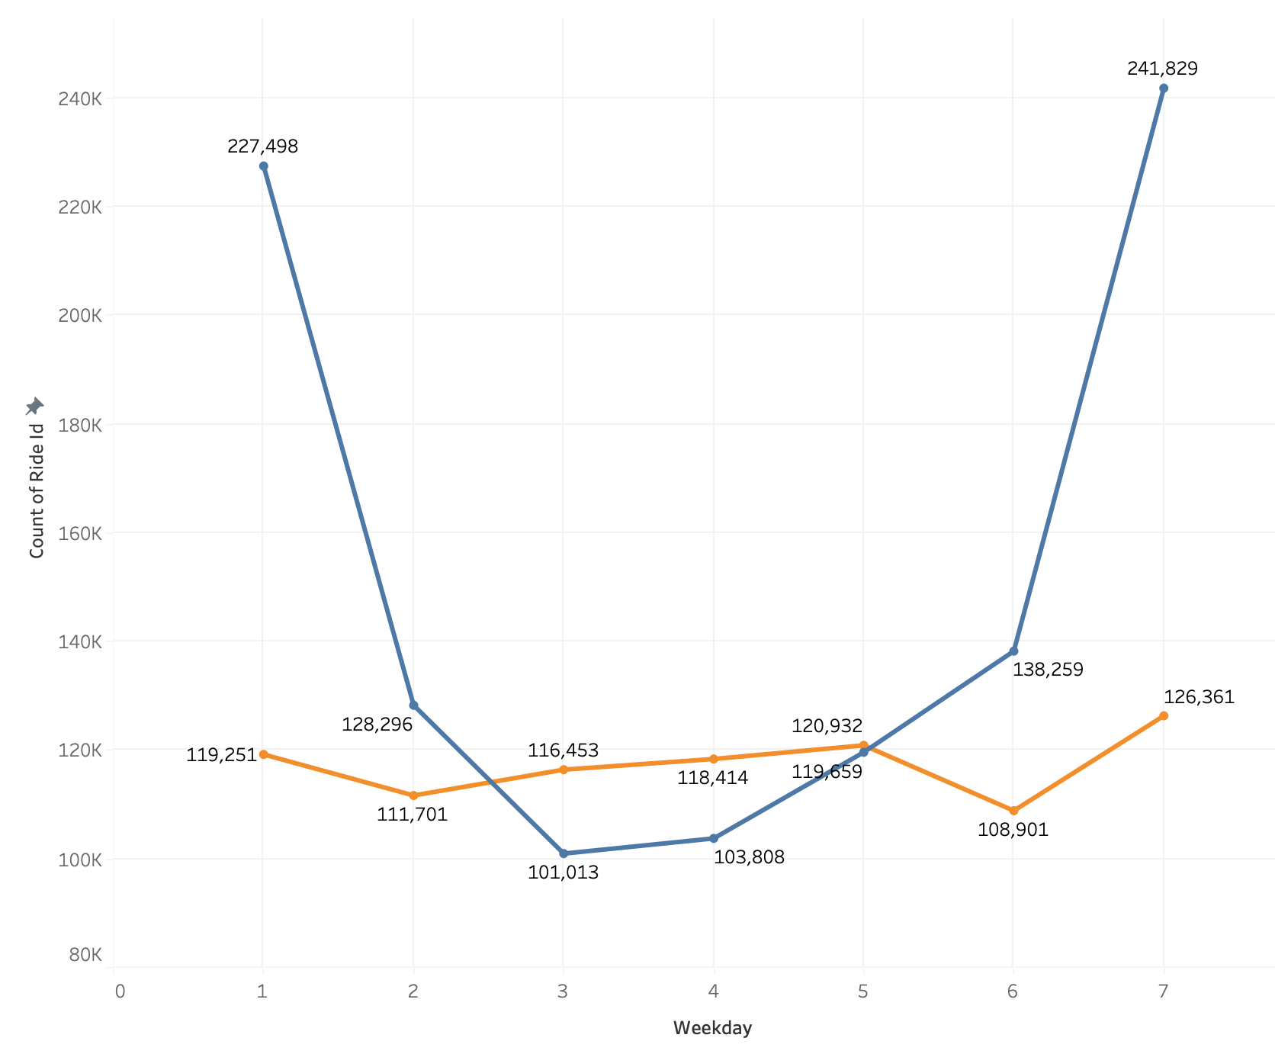
Weekday vs No. of Rides
Casual customers have highest number of rides during weekends. The gap between the number of rides during weekends and weekday is a lot.
Member customers have almost consistent number of number of rides throughout the week.

Slide 10
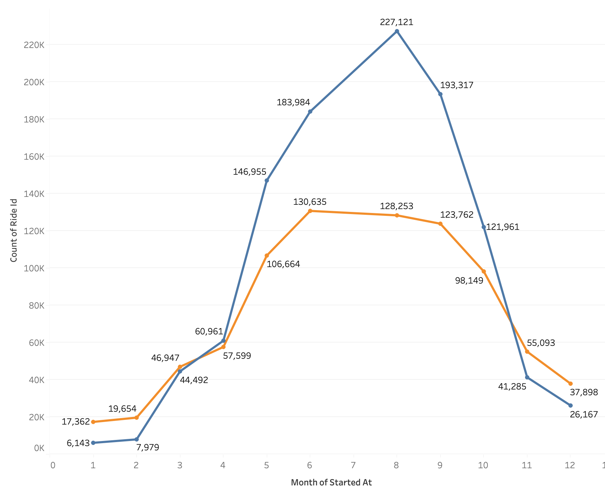
Months vs No. of Rides
Number of rides decreased during the winter seasons. Member users had more number of rides than Casual users in winter.
Casual Users had maximum numbers of rides in the month of August. There is a big gap between others month of summer and August.
Member Users had maximum number of rides in the month of July. There is not very big gap in the number of rides in the months of summer.

Slide 11
Summary
Casual users use the Cyclist app more often than Member users.
Casual users use the bikes for longer distances than the Member users.
Casual users’ longest bike rides occur during Sunday and Monday. Member users’ longest bike rides occur during weekend but the distance remains almost similar throughout the week.
Casual Users highest number of rides is during weekends. Member user has consistent number of rides throughout the week.
Highest of bike rides occurred during the Summer and number of rides decrease during the winter months. Though, during winter Member user did more rides than Casual Users

Slide 12
Conclusion
After looking at the all the findings the conclusion is Member users use the Cyclist app majority for the daily commute whereas Casual users use it for more leisure.

Slide 13
Recommendations
Few recommendation according to the patterns of usage of the Cyclist app by the users:
Do more promotion during Summer Season when maximum users use the app. This will also help in usage of bikes in winter season.
Casual Users use bike majorly on weekends. Make weekly pass or some other promotion that helps in increasing the number of rides throughout the week.
Casual Users have higher average length of ride than Member Users. Team can increase the amount on large length rides.

